Slide 1
The Internet and the Web

Slide 2
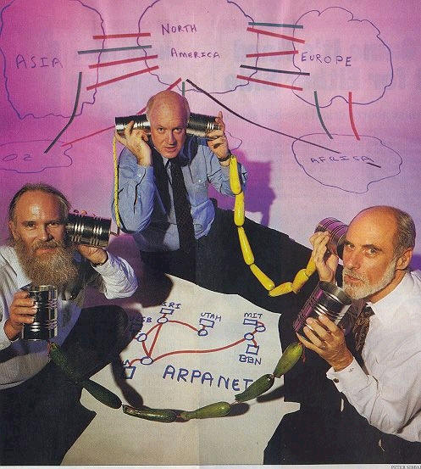
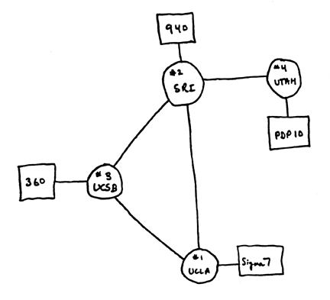
History of the Internet
ARPANET:
  Advanced Research Projects Agency Network – Dept. of Defense
  Funded by the U.S. government in the 1960s, lasted until 90's
  Allowed computers at leading universities and research organizations to communicate with each other over great distances
  First Working Version of the Packet Switching Network
  Picture copyright Peter Sibbald shows Vint Cerf, Steve Crocker and Jon Postel “founders of the Internet”
Notes:
The Internet was created to respond to two concerns: to establish a safe form of military communications and to create a means by which all computers could communicate.
Scientists were asked to come up with a solution to secure communications between large computer centers in case of a nuclear attack. They responded by inventing packet-switching and routers. By taking data messages and breaking them into small packets, each packet could be addressed and sent individually to a destination through a series of routers. The routers, like robot traffic cops, would send each packet along the optimum path to the next router, depending on traffic and availability.
This development also gave birth to a network that could be scaled up infinitely. It could be argued that the scientists who quietly built the first packet-switched network in 1969 were more important to the future than the NASA scientists who landed a man on the moon in the same year.

Slide 3
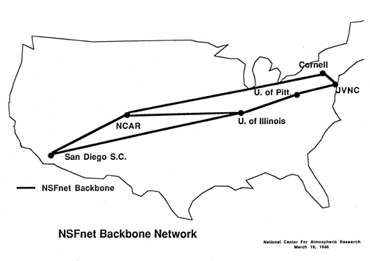
NSFNet – National Science Foundation Network
Connecting 5 supercomputers and the researchers using them, 1986
Merged with ARPANET in the late 1980s to become “The Internet”
Commercialization of the Internet - late 80’s. Early Internet was NOT allowed to be commercial!

Slide 4
Internet Basics
The Internet – connection of billions of computers using the Internet Protocol communication rules.
Computers send packets, chunk of data that has an address for the destination, an address for the source, the data and info about the data. Packets are also numbered in order so that when they are received at the destination, they can be reassembled into a message.
Packets travel over many kinds of communication channels: Ethernet cable, fiber optic cable, wireless channels, satellites, undersea cables
Internet was designed to work well over bad connections - will retry sending packets, reroute as needed to get through

Slide 6
Following Protocol
A protocol describes the specific technical steps involved in how information is actually transmitted. It is a set of rules on how a conversation happens
  Humans use protocols when they talk on the phone
  Computers must have protocols regarding error correction, size of packets, speed, frequency…
TCP/IP (Transmission Control Protocol/Internet Protocol)
  Information is broken into a sequence of small fixed-size units called IP packets
  Each packet has space for a chunk of data (e.g., piece of the novel), the IP addresses of the source and destination computers, and a sequence number
  The packets are sent over the Internet one at a time using whatever route is available
  Addresses are groups of numbers, unique one for each machine on the Net
Various sub-protocols handle email, web pages, file transfer, security

Slide 7
Internet Protocol is reliable
The Internet Protocol was designed to work with POOR connections
It is very difficult (and expensive) to keep a good quality connection between two points working long enough to send a huge gigabytes file
BUT it is not hard to keep a good connection for a few seconds - long enough to send a few packets (cheaper)
If a computer being used as a router is busy or out of service, packets are sent by a different route, so packets may not arrive in the same order at the destination as the order they were sent out. That’s why they are numbered

Slide 8
Networking terms
A router is a device in a network which receives a packet from a computer and sends the packet on to another computer. It is smart enough to decide which path is better in real time. (Cisco brand common)
An ISP = Internet Service Provider is a company which sells connections to the Internet. Largest are Comcast, AT&T, Spectrum, Verizon. They have the infrastructure of modems, DSL phone lines, satellites, cables, etc. and available connections to the Internet backbones.
  Factors to consider when choosing an ISP:
    Cost, local access numbers, services offered – email, web page hosting, news reading
    Reliability, speed, support and customer service
    Distance to connection point – DSL has limits on how far you are from switching station

Slide 9
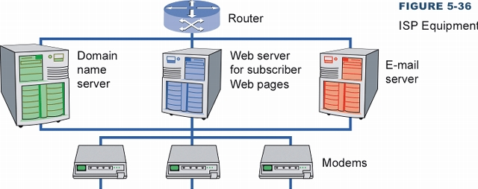
ISP Infrastructure

Slide 10
Home Networking
You need to have a modem (“modulator-demodulator”)
  DSL modem or cable modem or fiber modem
  Translates data from phone lines or cable lines into computer data
You need to have a router
  Accepts packets from modem and routes them to proper device in the home
Can buy one device these days that does both
Most routers these days support wired (Ethernet cables) and wireless (Wi-Fi) technology.
If getting a faster connection, make sure both modem and router are fast enough! Otherwise they are bottlenecks.

Slide 11
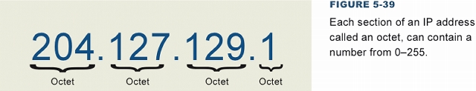
IP Addresses
IP addresses are addresses that identify computers on the Internet
  Try 173.194.203.106 – where is it? Google!
  Each address is 32 bits (4 groups of 8 bits)
  Each number between the dots is from 0 to 255 (all that 8 bits can hold)

Slide 12
Domain Names
Easy-to-remember names for Internet servers
Every domain name corresponds to a unique IP address
  Domain Name System – a set of computers which record a database of IP numbers and domain names – they have the “master copies” and are called “registrars”
Most specific information on the LEFT, most general on the right
Top Level Domain Names on the right end (most general)
  (examples) .gov .com .edu .net, country codes .jp, .uk, .us, .in
Subnets and Sub Domains (second, third, fourth level domains)
  uky.edu (University of Kentucky subdomain)
  cs.uky.edu (Computer Science department at UK)
  www.cs.uky.edu (web server at CS department at UK)
  ftp.cs.uky.edu (file server at CS department at UK)

Slide 13
Interesting domain names
look at the country code .tv - for island Tuvalu – commercially valuable – marketed to television stations, worth millions
Also be cautious! There are top level domains like .ads and .biz
  Amazon.biz is probably NOT part of the Amazon company!
  A domain name like mycompany.edu.com is NOT educational!

Slide 14
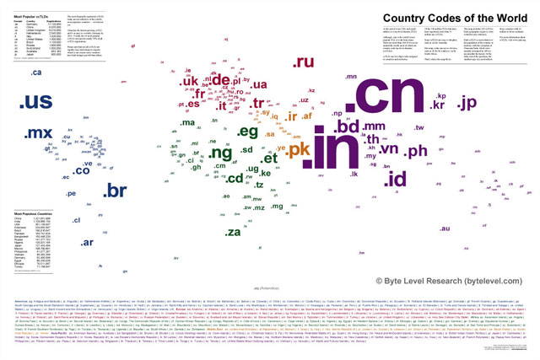
Top Level Domains - Country Codes

Slide 15
How to ask
How many hops to get to a site
  (windows) Command window, run “tracert website”
    Tells you which computers are being routed through, how long it takes
Who owns a web site?
  (windows) Command window, run “nslookup website or IP number”

Slide 16
Cybersquatting
When the Internet was young, it used only ONE company as registrar, "Network Solutions"
NS handled domain name requests on first come, first served basis - you paid the fee, you had the name for a year or two
Clever people registered domains that would be in high demand, like "apple.com“ (the people had nothing to do with Apple the company)
Then demanded payment “blackmail” to release them
Caused the creation of ICANN, addition of new rules about who can register a domain name
This still happens! People watch domain names to see when they expire and then grab them! Happened to Google not too long ago!

Slide 17
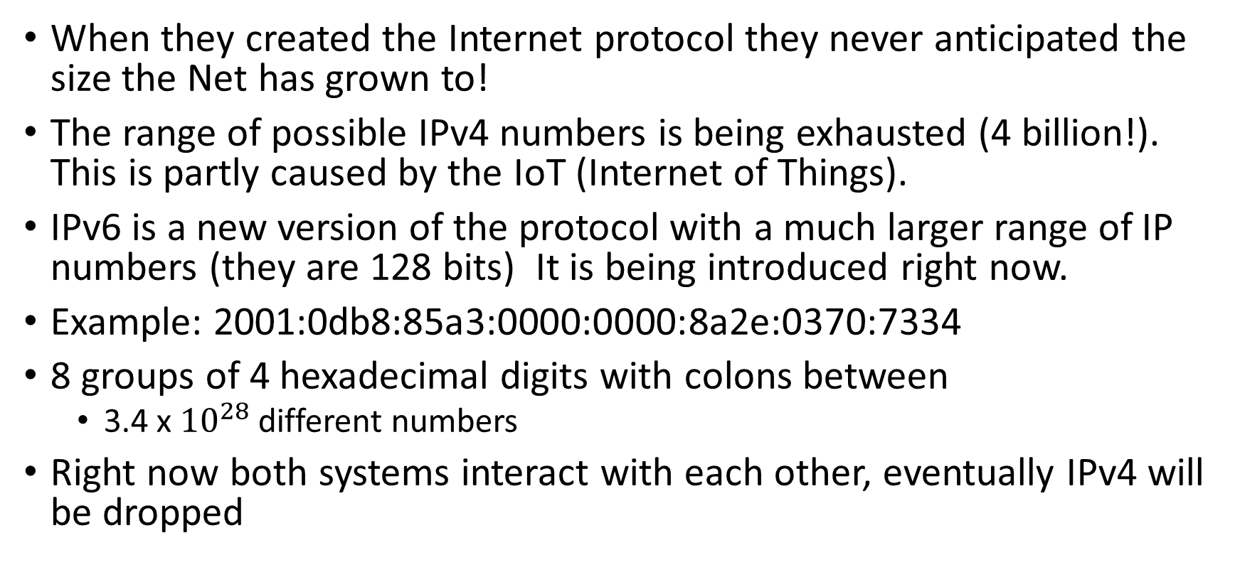
Problem with IP numbers
When they created the Internet protocol they never anticipated the size the Net has grown to!
The range of possible IPv4 numbers is being exhausted (4 billion!). This is partly caused by the IoT (Internet of Things).
IPv6 is a new version of the protocol with a much larger range of IP numbers (they are 128 bits) It is being introduced right now.
Example: 2001:0db8:85a3:0000:0000:8a2e:0370:7334
8 groups of 4 hexadecimal digits with colons between
  3.4 x ${10}^{28}$ different numbers
Right now both systems interact with each other, eventually IPv4 will be dropped

Slide 18
Dynamic vs. Static IP numbers
Static IP number is permanently assigned to a machine, is only used when that machine is logged in
When the problem with the IPv4 protocol realized, DHCP created
DHCP (Dynamic IP number) Your machine gets an IP number assigned every time it logs into the ISP, only for the duration of the connection
When you log out, someone else can reuse that IP number
ISP has to keep track of when you were on and what number you had then
Dynamic IP numbers are only a temporary fix until IPv6 is widespread

Slide 19
URL
Uniform Resource Locator
  Unique Internet address for site or file on that site
    Protocol could be http, mailto, ftp, news, …
    NOTE difference between http and https
Protocol identifies the means of access
Domain name contains the host and top-level domain
Path identifies the subdirectories within the Web site
URL
http://
www.nytimes.com/
Pages/cartoons/
Notes:
A URL is a Web site’s address. It is composed of several parts that help identify the Web document for which it stands.
The first part of the URL indicates the set of rules (or the protocol) used to retrieve the specified document. HTTP is most common. Another popular protocol is FTP.
The protocol is generally followed by a colon, two forward slashes, www (indicating World Wide Web), and then the domain name. Domain names consist of two parts: the host and the top-level domain (TLD).
At times, a forward slash and additional text follow the domain name. The information after the slash indicates a particular file or path (or subdirectory) within the Web site.

Slide 20
URLs
If the URL has just the protocol and domain name, like www.whitehouse.gov, or has protocol, domain name and folder(s), like www.Toyota.com/support/ then the web server will provide a file with a default name, like index.htm, home.htm, welcome.htm
URLs may have other characters like : and ? and =. These are usually parameters fed into a program on the web server to do some task, like searching or filling out a form or playing a video

Slide 21
The Internet and Copyright
All original material on the Net is copyrighted, © or not
Copyright is violated when you get economic benefit from using the material
  Exception of "academic fair use"
Plagiarism is different from copyright violation – it is presenting someone else's work as your own
  Credit your sources!

Slide 22
Wi-Fi
Wi-Fi uses certain radio frequencies to send data to many different devices, like a router, video game, smart phone, printers, televisions.
Wi-Fi has had many versions. Your older equipment may work with a faster version router, but won’t be as fast as newer equipment would be. Each version has a maximum speed in megabits per second.
  The industry is trying to standardize on labels like ”Wi-Fi 4” (if the equipment supports 802.11n), “Wi-Fi 5” (802.11ac) and “Wi-Fi 6” (802.11ax). They different in their range, their frequency, their bandwidth.
The speed of the version of Wi-Fi you use is ONE factor in determining the speed you get from your ISP.
Sometimes necessary to buy a Wifi extender/repeater to get signal to all parts of your house

Slide 23
Net Neutrality
“Common carrier” is the status ISPs want - they are not responsible for the content carried on their infrastructure, like a public utility
When the Internet was created, every packet was treated like every other packet. There was no discrimination based on user, content, website, platform, application, destination, etc. Every user has access to the same content equally.
With net neutrality, an ISP may not block, slow down or charge for prioritizing certain types of traffic
Without net neutrality, ISP can charge to be “in the fast lane”. Big established web sites can pay, little startups cannot.

Slide 24
The World Wide Web
The Web and the Internet are not the same thing; the Net is much older! The Net started in the 60’s, the Web in the 90’s
Web pages are files that contain HTML codes as well as content
Web servers: Computers programmed to send files to browsers running on other computers connected to the Internet
Web servers and their files make up the World Wide Web
The Web is the interface, the Internet is "behind the scenes"
The Internet is the “road,” the Web is just one form of “traffic” on the road
The Internet existed before the WWW interface – people used command line programs to retrieve email and files of all types, to search for information (gopher)

Slide 25
Web search engines
A search engine is a website that does web searches using keywords
Google.com, yahoo.com, bing.com
Most browsers will allow you to enter keywords in the address box or a search box. You can set your default search engine for your browser
Every search engine uses spiders (web crawlers) – programs which search the set of Web pages, looking for new material. When new key words are found, they are put in an index with a link that points to the page where they were found. Speeds up answer user queries

Slide 26
Google and PageRank
PageRank is the algorithm that Google uses to rank the hits that you get for your key words – which links appear on the front page
Somewhat based on how many other pages link to a specific page – the more links, the more important (higher-ranked) the page
Details are kept a secret!
Search Engine Optimization – companies who promise clients that they will get the client’s web page “on the front page of Google” when certain keywords are entered
A lot of SEO is “cheating”. Hiding irrelevant words on a web page to cause it to rank higher, putting the real content of a page in a jpg!

Slide 27
Web Search Tips
Look up “advanced search” in most search engines
Quotes – putting quotes around a phrase will reduce number of hits
Using a + before a keyword means it must appear on the hit
Using site: in a Google search searches only that domain name
Using filetype: like pdf, docx will find only files with that extension
https://support.google.com/websearch/answer/2466433?hl=en
  Punctuation marks and symbols that Google recognizes

